Slide 1
Scaling and Indexes
LAPOP Summer School in International Survey Methods Drew Engelhardt andrew.engelhardt@stonybrook.edu amengelhardt.com/teaching

Slide 2
Topics
Why scaling?
Process of Measurement
Measurement Error
Validating Scales
Confirmatory factor analysis
This afternoon: Factor analysis applications

Slide 3
First: Introductions
Name
What you do
Motivation for attending the survey methods workshop

Slide 4
Topics
Why scaling?
Process of Measurement
Measurement Error
Validating Scales
Confirmatory factor analysis
This afternoon: Factor analysis applications

Slide 5
Process of measurement
Conceptualization: define concept
Operationalization: identify appropriate measure
Validation: assess fit between measure and concept

Slide 6
Example: Measuring Nationalism
Start with motivation:
Greater levels of nationalism arguably underlie the founding of many nations (Anderson 1983)
Ask what we should observe:
Greater nationalism makes one pro- their nation and anti-other nations

Slide 7
First: conceptualization
Nationalism: commitment to the denigration of alternatives to a nation’s principles and institutions, which is reciprocally tied to chauvinism toward outsiders (deFiguieredo and Elkins 2003; Conover and Feldman 1987)
If individuals vary, we want to make sure we capture these differences

Slide 9
Second: operationalization
“The world would be a better place if people from other countries were more like Americans.”
1. Strongly disagree 2. Disagree 3. Agree 4. Strongly agree

Slide 10
Low Nationalism
High Nationalism
Low Nationalism
High Nationalism
Low Nationalism
High Nationalism
Low Nationalism
High Nationalism

Slide 11
Why care about variation?
Accurately reflect reality
Improve hypothesis testing (Bakker and Lelkes 2018)

Slide 12
Survey response reprise
People have reasons for and against propositions
People average across considerations salient at time of question, with salience defined by accessibility (chronic or temporary)
People then map this constructed judgment onto available response options
Explains: response instability, response effects
Challenges: reported attitude depends on accessible considerations and response recording
(Zaller and Feldman 1992; Tourangeau, Rips, and Ransinski 2000)

Slide 13
Second: operationalization
“The world would be a better place if people from other countries were more like Americans.”
“Generally, the more influence America has on other nations, the better off they are.”
“Generally speaking, America is no better than most countries.” (reverse-scored)
1. Strongly disagree 2. Disagree 3. Agree 4. Strongly agree

Slide 14
Operationalization II: Creating Scales
Sum together responses of relevant items
But what if dissimilar response scales?
Rescale to min-max (0-1) and sum
Z-score and sum
Z-score: subtract item average and divide by item standard deviation for each respondent
But what if we want to assign weights to different items?
Multiply by weight before summing (researcher-defined weights)
Factor analysis (model-defined weights)

Slide 15
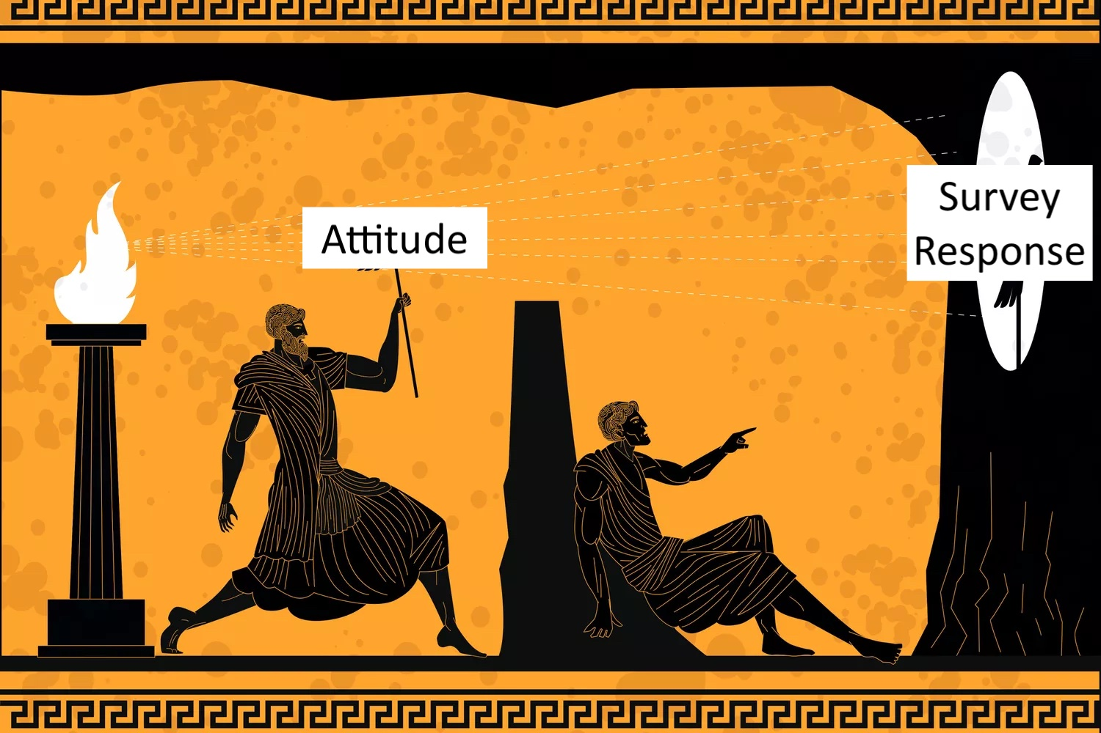
Plato: Early Survey Methodologist
Data = Model + error
Slippage between concept and operationalization
Use scales and indexes to try and minimize error, but can never eliminate
Allegory of the Cave

Slide 16
Measurement Error
Random Error
Systematic Error

Slide 17
Random Error
Chance fluctuations which affect the measurement of some phenomenon (Carmines and Zeller 1980, 13)
Can come from:
Ambiguous instructions, enumerator response coding, question delivery, enumerator fatigue, survey context distractions
Consequences: adds noise to recorded information
Attenuates observed relationships
Observed = True + error

Slide 18
Systematic Error
Patterned (nonrandom) influences from third factor(s) affecting the measurement of some phenomenon
Sources:
Response sets (e.g., acquiescence)
Interpersonal incomparability (e.g., feeling thermometer problem)
Social desirability
Consequences: over-/under-estimates of construct of interest or relationships between constructs if share error
Biases observed relationships
Observed = True + bias + error

Slide 19
Scales and Acquiescence Bias
Respondent “agrees” to a survey question. Why?
Also challenge for scales (unbalanced scales)
Balanced scales
Include equal shares of positively worded (PW) & negatively worded (NW) items
NW alternatively termed “reverse coded”
“Average” out ARS, but requires PW and NW items equally capture concept and acquiescence response style (ARS)
Item-specific
Ex. “How important is it that…” vs. “Do you agree or disagree that…”

Slide 20
Topics
Why scaling?
Process of Measurement
Measurement Error
Validating Scales
Confirmatory factor analysis
This afternoon: Factor analysis applications

Slide 21
Validating Scales
Measurement reliability
Measurement validity

Slide 22
Measurement Reliability
Extent to which scores measured at one time and place with one instrument predict scores at another time and/or place and perhaps measured with a different instrument (Revell and Condon 2019, 1396)
But also: consistency of measurement across items
Are items capturing a homogenous construct?
What’s the signal-to-noise ratio of our scale?

Slide 23
Factors Affecting Measurement Reliability
Random measurement error
Scale length

Slide 24

Evaluating Measurement Reliability
Average/median inter-item correlation; item-total correlations
Split-half correlations: explore distribution of all possible divisions of items
Cronbach’s ⍺: proportion of variance in a scale attributable to a common source
$α= \frac{scale variance −∑item variance}{scale variance}∗\frac{n}{n−1}$
Most common, but has issues given strong assumptions (see: McNeish 2018)
McDonald’s ⍵: proportion common variance like ⍺, but with relaxed assumptions
Model-based estimate rather than algebraic calculation
Note: most estimates of reliability like ⍺ and ⍵ trend toward 1 as the number of items increases

Slide 25
Measurement Validity
Does a variable measure what it is supposed to measure. Observed scores on an item interpreted as capturing intended (latent) concept. (Bollen 1989, 184)
Types (Adcock and Collier 2001)
Content: degree to which indicator fully represents concept of interest
Does our scale have items covering its full definition?
Discriminant: degree to which alternative indicators of same concept correlate
Does our scale relate to other established measures of the same concept?
Nomological/construct: degree to which established causal hypotheses again find support when using new measure
Does our scale replicate existing findings?

Slide 26
Factors Affecting Measurement Validity
Systematic measurement error
Question wording

Slide 27
Evaluating Measurement Validity
Via correlations
Discriminant: compare summed scale with other measures of same concept
Nomological: compare summed scale to other theoretically relevant measures
Via Confirmatory Factor Analysis
Test hypothesis about model-data fit given relationships among scale items and between (un)related constructs

Slide 28
Topics
Why scaling?
Process of Measurement
Measurement Error
Validating Scales
Confirmatory factor analysis
This afternoon: Factor analysis applications

Slide 29
Confirmatory Factor Analysis (CFA)
Measurement model relating observed items to unobserved factors
Hypothesis: some latent construct exists which causes the correlations we observe between items
Recall: nationalism
CFA lets us test this hypothesis. Does the model we propose (e.g., a 3-item set captures a single concept) fit the data?

Slide 30
Concept
Item 1
Item 2
Item 3
ε₁
ε₂
ε₃

Slide 31
Concept
?
Item 1
Item 2
Item 3
Item 4
ε₁
ε₂
ε₃
ε₄

Slide 32
?
Concept
Concept
Item 1
Item 2
Item 3
Item 4
Item 5
Item 6
Item 7
Item 8
ε₁
ε₂
ε₃
ε₄
ε₅
ε₆
ε₇
ε₈

Slide 33




Concept
(η₁)
$$λ_{1}$$
$$λ_{4}$$
$$λ_{2}$$
$$λ_{3}$$
Item 1
Item 2
Item 3
Item 4
ε₁
ε₂
ε₃
ε₄

Slide 34
CFA Foundation: Common Factor Model
Observed (measured) items are a linear function of one or more common factors and a unique factor
Items have shared (common) variance & unique variance which FA separates
Common variance: seen in correlations among items
Unique variance: reliable, indicator-specific variance and measurement error

Slide 35
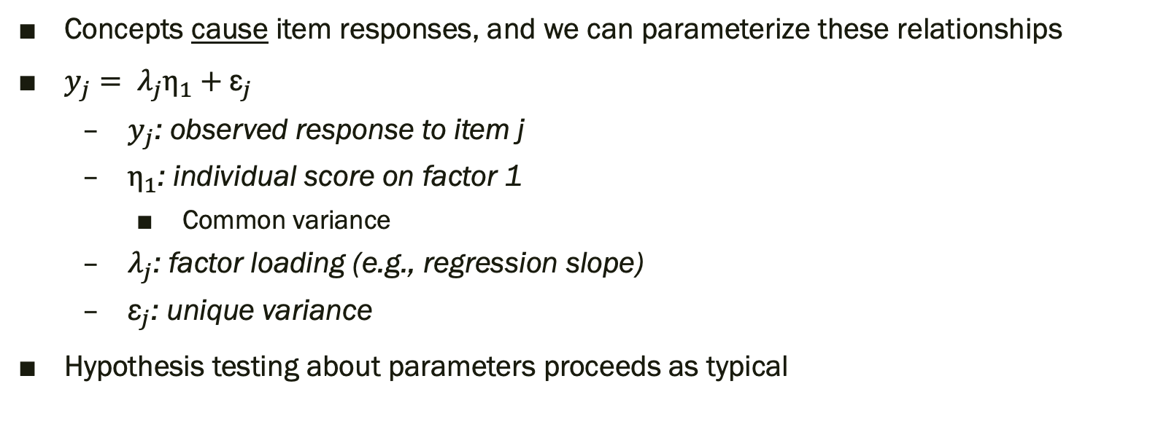
CFA as linear regression
Concepts cause item responses, and we can parameterize these relationships
$y_{j}= λ_{j}η_{1}+{\text{ε}}_{j}$
$y_{j}$: observed response to item j
$η_{1}$: individual score on factor 1
Common variance
$λ_{j}$: factor loading (e.g., regression slope)
${\text{ε}}_{j}$: unique variance
Hypothesis testing about parameters proceeds as typical

Slide 36
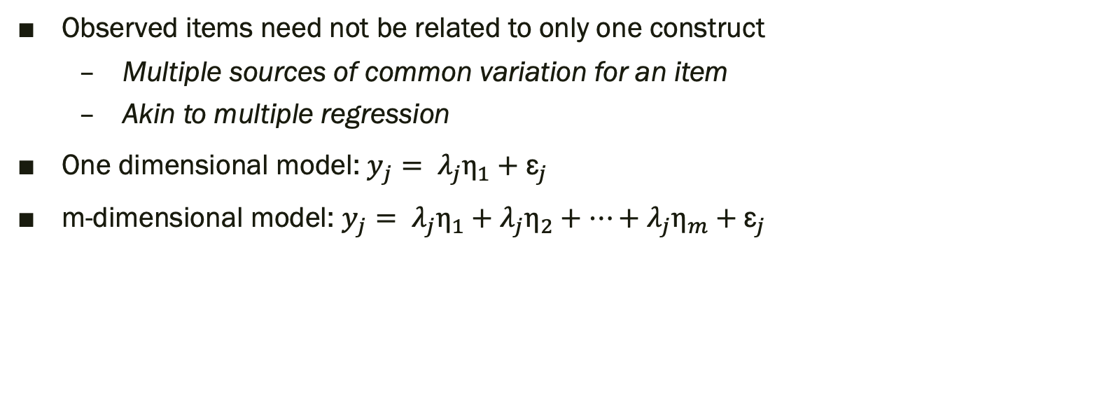
CFA as linear regression
Observed items need not be related to only one construct
Multiple sources of common variation for an item
Akin to multiple regression
One dimensional model: $y_{j}= λ_{j}η_{1}+{\text{ε}}_{j}$
m-dimensional model: $y_{j}= λ_{j}η_{1}+λ_{j}η_{2}+…+λ_{j}η_{m}+{\text{ε}}_{j}$

Slide 37
Concept
Concept
Item 1
Item 2
Item 3
Item 4
Item 5
Item 6
Item 7
Item 8
ε₁
ε₂
ε₃
ε₄
ε₅
ε₆
ε₇
ε₈

Slide 38
Identification and Estimation
CFA has many freely estimated parameters, requiring a model identification strategy
Need:
Scale for the latent variable
Sufficient information for statistical identification

Slide 39
Identification and Estimation
Scaling the latent variable (what are its units?)
Option 1: fix the latent variable’s metric to that of one of its indicators
Factor loadings sized relative to this marker indicator
One-unit change in LV defined by this item’s units
Option 2: fix the latent variable’s variance
Usually 1 for standardization
Factor loadings now in standard deviation units

Slide 40
Identification and Estimation
Statistical identification depends on freely estimated parameters and knowns
Knowns: item information (usually item variances and covariances)
Unknowns: factor loadings, error (co)variances

Slide 41
Identification and Estimation
CFAs typically estimated via Maximum Likelihood
Find combination of parameters which make observed data most likely

Slide 42
Model Fit
How well does the model-predicted variance-covariance matrix reflect the sample variance-covariance matrix?
Perfect fit: 𝛘²(classic, but used less in applied settings)
Does the predicted VCOV perfectly captured the sample VCOV?
Absolute fit: Standardized root mean square residual (SRMR)
Average difference between observed and predicted correlations among variables
Parsimony correction: Root mean square error of approximation (RMSEA)
Given 𝛘² and degrees of freedom (DF), does model fit reasonably well in population?
Comparative fit: comparative fit index (CFI)
How well does the model fit relative to null model where all item correlations are 0?

Slide 43
Model Fit Interpretation Guidelines
Consider information from multiple fit indices
𝛘²: p > 0.05, cannot reject null that model fits data perfectly
SRMR: 0-1, values nearer 0 indicate small residuals
Values < .08 typically seen as good
RMSEA: 0-1; typically reported with 90% confidence intervals
Values < .06 good; >.08 and < .10 mediocre; >.10 bad
Use confidence interval and estimate to think about range of possible model quality
CFI: 0-1; higher values denote closer correspondence between model and data
Values > .90 seen as acceptable, >.95 good
Note: thresholds for SRMR, RMSEA, and CFI based on simulation studies and are guidelines only. Ongoing debate about what exactly indicates “good fit” among methodologists

Slide 44
Why care about model fit?
Model establishes global hypothesis about relationships among items. We want to make sure data support this hypothesis.
Applications:
Is my proposed scale valid (e.g., unidimensional)?
Are the relationships between items consistent with one hypothetical reason and inconsistent with another?
Consider: Δ 𝛘² significant? Do SRMR, RMSEA, and CFI indicate good or poor fit?
Challenge: notions of “good fit” or ”meaningful change” in fit are subjective

Slide 45
Interpreting CFA Models
Pay attention to factor loadings: larger are better
Pay attention to model fit: does hypothesized model fit the data well

Slide 46
Application: Feldman and Huddy (2010) “The Structure of White Racial Attitudes”
Investigations of White racial prejudice (specifically anti-Black racism) are fractured, using myriad measures. Are attitudes as varied as these measures or are there common features?
Example measures: stereotypes, explanations for inequality, racial resentment, feeling thermometers
Propose tripartite structure
Overt racism (innate differences)
Denial of discrimination
Motivation and values

Slide 47
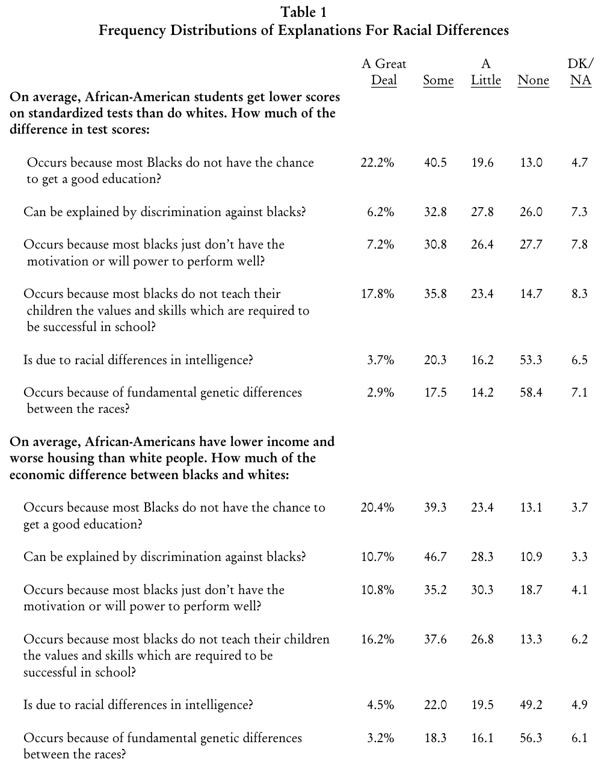
(Feldman and Huddy 2010)

Slide 48
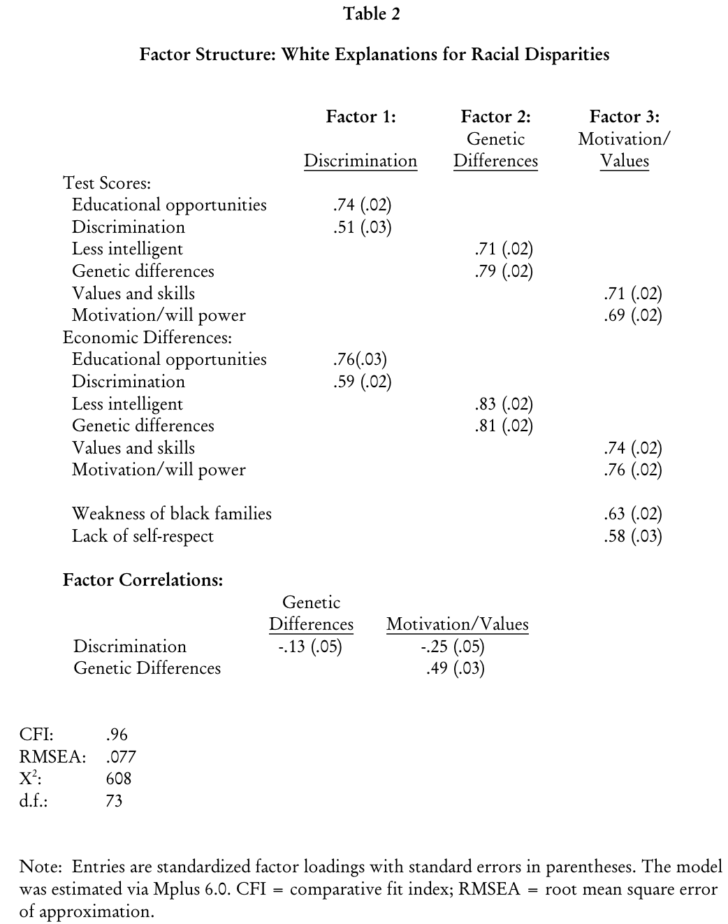
(Feldman and Huddy 2010)

Slide 49
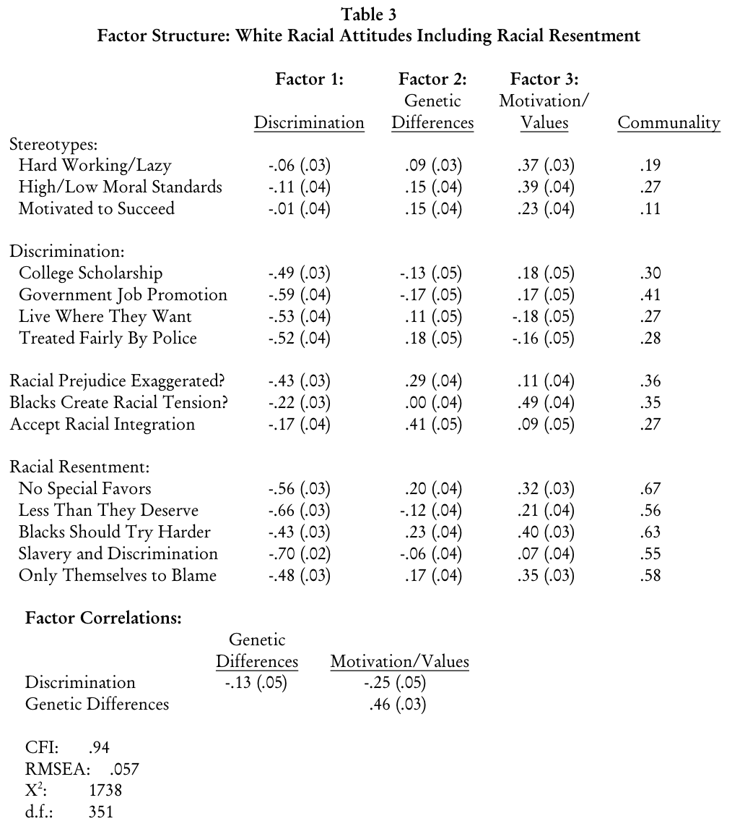
Communality: share of variance in an item attributable to common factors
.19 = 19% of the variance in hardworking/lazy stereotyping comes from the 3 factors here.
(Feldman and Huddy 2010)

Slide 50
CFA and Error Structures
Items correlated because of common variance which defines our factor
Common variance: substantive, but also method
But we want only substantive in our scale, so what can we do? Model these errors!
Goal: focus attention to substantive variance by specifying a model more accurately characterizing the world
Specify a correlation between errors: items covary for reasons unrelated to shared influence of the common factor

Slide 51
Example: Racial resentment
“Generations of slavery and discrimination have created conditions that make it difficult for Blacks to work their way out of the lower class.”
“Over the past few years, Blacks have gotten less than they deserve.”
“It’s really a matter of some people not trying hard enough; if Blacks would only try harder they could be just as well off as whites.”
“Irish, Italians, Jewish and many other minorities overcame prejudice and worked their way up. Blacks should do the same without any special favors.”
Responses: Strongly agree, agree, neither agree nor disagree, disagree, strongly disagree

Slide 52


Racial Resentment
(η₁)
$$λ_{1}$$
$$λ_{4}$$
$$λ_{2}$$
$$λ_{3}$$
Generations
Deserve Less
Try harder
Irish
ε₁
ε₂
ε₃
ε₄

Slide 53
Validity Evidence in CFA
Large factor loadings indicate items are valid indicators of concept
Indicators for one construct do not load together with indicators from another construct
Correlations between factors theoretically sensible

Slide 54
Validation Applications via CFA
Question wording differences
Do different phrasings see (dis)similar factor loadings?
Measurement equivalence/invariance (cross-cultural or temporal comparisons)
Multi-group CFA
Multiple Indicators, Multiple Causes (MIMIC) models (“CFA with covariates”)
Multitrait-multimethod (MTMM) Analysis

Slide 55
CFA: Strengths and Weaknesses
Strengths
Testable model
Purges random measurement error
Can include hypotheses about error structures (e.g., estimate method effects like acquiescence bias)
Weaknesses
Specification searches
Data normality

Slide 56
CFA vs. Exploratory Factor Analysis
CFA focuses on researcher-defined factors (how many, which items define them)
Want data-driven? EFA
We hypothesize a number of factors and items then load on all to different degrees
Helps us:
Determine number of factors from a pool of items
Assign indicators to appropriate factors
EFA typically used earlier in scale development. CFA for validation of scale in later collections.

Slide 57

EFA vs. Principal Components Analysis
Both construct dimensions from observed variables but…
PCA focuses on finding components maximizing any variance across items
Components are weighted sum of items
Relationships among observed variables cause the components
$y_{j}= λ_{j}η_{1}$
EFA finds factors based on common variance across items
Observed variables are weighted sums of unobserved factors and unique variance
Relationships among observed variables caused by unobserved factors
$y_{j}= λ_{j}η_{1}+{\text{ε}}_{j}$

Slide 58
Useful but not addressed: Item Response Theory
Model persons and items simultaneously
Items have different parameters, typically discrimination and difficulty
People scored on a latent continuum which items also fall on (difficulty)
What’s the probability we observe some response given a person’s score on this unobserved construct?
Helpful for
Item retention/inclusion in scale development (incl. item banks)
Computerized Adaptive Testing
Educational testing is a major use case (e.g., GRE)

Slide 59
Additional Resources

Slide 60
Articles: Technical and Theoretical
Andrews, Frank M. 1984. “Construct Validity and Error Components of Survey Measures: A Structural Modeling Approach.” Public Opinion Quarterly 48(2): 409–42.
Bakker, Bert N, and Yphtach Lelkes. 2018. “Selling Ourselves Short? How Abbreviated Measures of Personality Change the Way We Think about Personality and Politics.” The Journal of Politics 80(4): 1311–25.
Bollen, Kenneth A. 2002. “Latent Variables in Psychology and the Social Sciences.” Annual review of psychology 53(1): 605–34.
Borsboom, Denny. 2006. “The Attack of the Psychometricians.” Psychometrika 71(3): 425–40.
Fabrigar, Leandre R, Duane T Wegener, Robert C MacCallum, and Erin J Strahan. 1999. “Evaluating the Use of Exploratory Factor Analysis in Psychological Research.” Psychological Science 4(3): 272–99.
McNeish, Daniel. 2018. “Thanks Coefficient Alpha, We’ll Take It from Here.” Psychological Methods 23(3): 412–33.
Revelle, William, and David M. Condon. 2019. “Reliability from α to ω: A Tutorial.” Psychological Assessment 31(12): 1395–1411.
Rhemtulla, Mijke, Riet van Bork, and Denny Borsboom. 2020. “Worse than Measurement Error: Consequences of Inappropriate Latent Variable Measurement Models.” Psychological Methods 25(1): 30–45.
Saris, Willem E, Albert Satorra, and William M van der Veld. 2009. “Testing Structural Equation Models or Detection of Misspecifications?” Structural Equation Modeling: A Multidisciplinary Journal 16(4): 561–82.
van Der Veld, William, and Willem E Saris. 2004. “Separation of Error, Method Effects, Instability, and Attitude Strength.” In Studies in Public Opinion Attitudes, Nonattitudes, Measurement Error and Change, eds. Willem E Saris and Paul M Sniderman. Princeton: Princeton University Press, 37–59.
Wijsen, Lisa D., Denny Borsboom, and Anna Alexandrova. 2022. “Values in Psychometrics.” Perspectives on Psychological Science 17(3): 788–804.

Slide 61
Articles: Applications
Brown, Robert A, and Todd C Shaw. 2002. “Separate Nations: Two Attitudinal Dimensions of Black Nationalism.” The Journal of Politics 64(1): 22–44.
Davidov, Eldad. 2009. “Measurement Equivalence of Nationalism and Constructive Patriotism in the ISSP: 34 Countries in a Comparative Perspective.” Political Analysis 17(1): 64–82.
Pérez, Efrén O. 2011. “The Origins and Implications of Language Effects in Multilingual Surveys: A MIMIC Approach with Application to Latino Political Attitudes.” Political Analysis 19(4): 434–54.
Lupton, Robert N, William M Myers, and Judd R Thornton. 2015. “Political Sophistication and the Dimensionality of Elite and Mass Attitudes, 1980−2004.” The Journal of Politics 77(2): 368–80.
Roos, J Micah, Michael Hughes, and Ashley V Reichelmann. 2019. “A Puzzle of Racial Attitudes: A Measurement Analysis of Racial Attitudes and Policy Indicators.” Socius: Sociological Research for a Dynamic World 5(2): 237802311984273–14.
Saavedra Cisneros, Angel, Tony E. Carey, Darrin L. Rogers, and Joshua M. Johnson. 2022. “One Size Does Not Fit All: Core Political Values and Principles across Race, Ethnicity, and Gender.” Politics, Groups, and Identities.

Slide 62
Books
Bollen, Kenneth A. 1989. Structural Equations with Latent Variables. New York: John Wiley & Sons.
Brown, Timothy A. 2015. Confirmatory Factor Analysis for Applied Research. New York: Guilford Press.
Fabrigar, Leandre R, and Duane T Wegener. 2012. Exploratory Factor Analysis. New York: Oxford University Press.

Slide 63
Web and R
http://personality-project.org/readings-measurement.html#psycho
https://lavaan.ugent.be/

